Slide 1
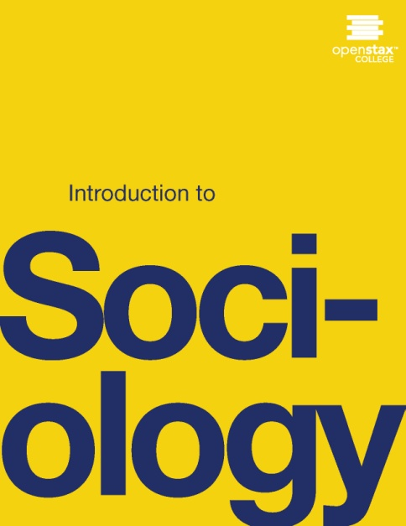
INTRODUCTIOn To SOCIOLOGy 2E
Chapter 16 EDUCATION
PowerPoint Image Slideshow

Slide 2
Figure 16.1
Students who do graduate from college are likely to begin a career in debt. (Photo courtesy of Kevin Dooley/flickr)

Slide 3
Figure 16.2
As can be seen by the trend in the graph, while the Federal Pell Grant maximum has risen slightly between 1976 and 2008, it has not been able to keep pace with the total cost of college.

Slide 4
Figure 16.3
These children are at a library in Singapore, where students are outperforming U.S. students on worldwide tests. (Photo courtesy of kodomut/flickr)

Slide 5
Figure 16.4
Parents teaching their children to cook provide an informal education. (Photo courtesy of eyeliam/flickr)

Slide 6
Figure 16.5
How has your state’s revenue affected your educational opportunities? (Graph courtesy of Census of Governments: Survey of School System Finances 2012)

Slide 7
Figure 16.6
The teacher’s authority in the classroom is a way in which education fulfills the manifest functions of social control. (Photo courtesy of Tulane Public Relations/flickr)

Slide 8
Figure 16.7
Starting each day with the Pledge of Allegiance is one way in which students are taught patriotism. (Photo courtesy of Jeff Turner/flickr).

Slide 9
Figure 16.8
Conflict theorists see the education system as a means by which those in power stay in power. (Photo courtesy Thomas Ricker/flickr)

Slide 10
Figure 16.9
President Eisenhower sent members of the 101st Airborne Division from Kentucky to escort black students into Little Rock Central High School after the governor of Arkansas tried to deny them entry. (Photo courtesy of the U.S. Army)

Slide 11
Figure 16.10
The debate over the performance of charter schools vs. public schools is a charged one. Dozens of studies have been made on the topic, and some, as reflected in Stanford's CREDO study above, do not support the claim that charter schools always outperform public schools. (Source: Based on the CREDO study Multiple Choice: Charter School Performance in 16 States)

