Slide 1
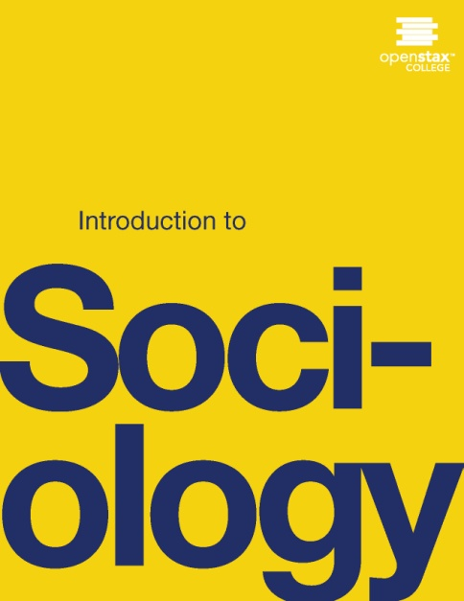
INTRODUCTION TO SOCIOLOGY 2E
Chapter 13 AGING AND THE ELDERLY
PowerPoint Image Slideshow

Slide 2
Figure 13.1
Society's view of the elderly is likely to change as the population ages. (Photo courtesy of sima dimitric/flickr)

Slide 3
Figure 13.2
How old is this woman? In modern U.S. society, appearance is not a reliable indicator of age. In addition to genetic differences, health habits, hair dyes, Botox, and the like make traditional signs of aging increasingly unreliable. (Photo courtesy of the Sean and Lauren Spectacular/flickr)

Slide 4
Figure 13.3
This population pyramid shows the age distribution pattern for 2010 and projected patterns for 2030 and 2050 (Graph courtesy of the U.S. Census Bureau).

Slide 5
Figure 13.4
As senior citizens begin to make up a larger percentage of the United States, the organizations supporting them grow stronger. (Photo courtesy of Congressman George Miller/flickr)

Slide 6
Figure 13.5
This U.S. Census graph shows that women live significantly longer than men. However, over the past two decades, men have narrowed the percentage by which women outlive them. (Graph courtesy of the U.S. Census Bureau)

Slide 7
Figure 13.6
In this U.S. Census pyramid chart, the baby boom bulge was aged thirty-five to fifty-five in 2000. In 2010, they were aged forty-five to sixty-five. (Graph courtesy of the U.S. Census Bureau)

Slide 8
Figure 13.7
Cultural values and attitudes can shape people’s experience of aging. (Photo courtesy of Tom Coppen/flickr)

Slide 9
Figure 13.8
Aging can be a visible, public experience. Many people recognize the signs of aging and, because of the meanings that culture assigns to these changes, believe that being older means being in physical decline. Many older people, however, remain healthy, active, and happy. (Photo courtesy of Pedro Riberio Simoes/flickr)

Slide 10
Figure 13.9
Aging is accompanied by a host of biological, social, and psychological changes. (Photo courtesy of Michael Cohen/flickr)

Slide 11
Figure 13.10
In Harold and Maude, a 1971 cult classic movie, a twenty-something young man falls in love with a seventy-nine year-old woman. The world reacts in disgust. What is your response to this picture, given that that the two people are meant to be lovers, not grandmother and grandson? (Photo courtesy of luckyjackson/flickr)

Slide 12
Figure 13.11
As same-sex marriage becomes a possibility, many gay and lesbian couples are finally able to tie the knot—sometimes as seniors—after decades of waiting. (Photo courtesy of Fibonacci Blue/flickr).

Slide 13
Figure 13.12
A young man sits at the grave of his great-grandmother. (Photo courtesy of Sara Goldsmith/flickr)

Slide 14
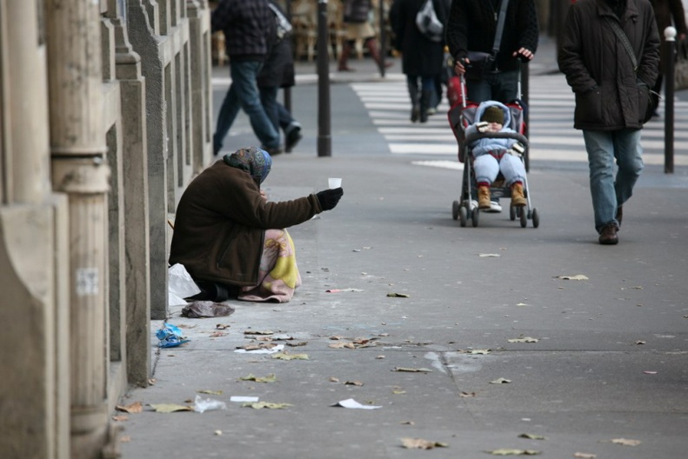
Figure 13.13
While elderly poverty rates showed an improvement trend for decades, the 2008 recession has changed some older people’s financial futures. Some who had planned a leisurely retirement have found themselves at risk of late-age destitution. (Photo (a) courtesy of Michael Cohen/flickr; photo (b) courtesy of Alex Proimos/flickr)

Slide 15
Figure 13.14
Are these street signs humorous or offensive? What shared assumptions make them humorous? Or is memory loss too serious to be made fun of? (Photo courtesy of Tumbleweed/flickr)

Slide 16
Figure 13.15
World War II (1941–1945) veterans and members of an Honor Flight from Milwaukee, Wisconsin, visit the National World War II Memorial in Washington, DC Most of these men and women were in their late teens or twenties when they served. (Photo courtesy of Sean Hackbarth/flickr)

Slide 17
Figure 13.16
Does being old mean disengaging from the world? (Photo courtesy of Candida Performa/Wikimedia Commons)

Slide 18
Figure 13.17
Would you want to spend your retirement here? A growing elderly prison population requires asking questions about how to deal with senior inmates. (Photo courtesy of Claire Rowland/Wikimedia Commons)

Slide 19
Figure 13.18
At a public protest, older people make their voices heard. In advocating for themselves, they help shape public policy and alter the allotment of available resources. (Photo courtesy of longislandwins/flickr).

Slide 20
Figure 13.19
The subculture of aging theory posits that the elderly create their own communities because they have been excluded from other groups. (Photo courtesy of Icnacio Palomo Duarte/flickr).

